Slide 1

Ensemble Methods and K-NN
Module 6CM521: Frontiers in AI and Data Science
Ioannis Tsioulis (MC)
Slides acknowledgements:
Dr Aaisha Makkar

Slide 2
Outlook
Tree ensembles:
  Bagging and Random Forest (RF)
  Boosting (boosted trees)
K-NN

Slide 3
Classification Tree
Disadvantages of the Tree-Structured Approach
Do not predict very accurately compared to other kinds of machine learning models, which is due to the greedy nature of the tree construction algorithms, e.g. information gain or Gini index, which introduce overfitting problems very easily.
Trees are unstable
  Small changes to the input data can have large effects on the structure of the tree due to the hierarchical nature of the tree-growing process.
Solution: bagging and boosting.

Slide 4
Model Averaging
Previously, we focused on machine learning procedures that produce a single set of results:
  A regression equation, with one set of regression coefficients or smoothing parameters.
  A classification or regression tree with one set of leaf nodes.
Model selection is often required: a measure of fit associated with each candidate model.
Here, the discussion shifts to machine learning building on many sets of outputs that are aggregated to produce results.

Slide 5
Model Averaging (cont’d)
The aggregating procedure makes multiple tree-growing passes over the data.
On each pass, inputs X (a bootstrap sample drawn by the bagging process) are linked with outputs Y, just as for a single tree.
However, of interest now is the collection of all the results from these different trees for aggregating votes.
Aggregated results have several important benefits.

Slide 6
Model Averaging (cont’d)
Averaging over a collection of fitted values can help to avoid overfitting.
It tends to cancel out the uncommon features of the data captured by a specific model. Therefore, the aggregated results are more stable.
A large number of fitting attempts can produce very flexible fitting functions.
Putting the averaging and the flexible fitting functions together has the potential to break the bias-variance tradeoff.

Slide 7
Model Averaging (cont’d)
Ideally, one would have two random samples from the same population: a training dataset and a test dataset. The fit measure from the test data would be a better indicator of how accurate the classification is.
Often there is only a single dataset. The data are split up into several randomly chosen, non-overlapping, partitions of about the same size. With ten partitions, each partition is part of the training data in nine analyses and serves as the test data in one.
The model selection is based on choosing the one with the smallest cross-validation prediction error.

Slide 8
Outlook
Tree ensembles:
  Bagging and Random Forest (RF)
  Boosting (boosted trees)
K-NN

Slide 9
Bagging: Bootstrap Aggregating
There is a very powerful idea in the use of subsamples of the data and in averaging over subsamples through bootstrapping.
Bagging exploits that idea to address the overfitting issue in a more fundamental manner.
It was invented by Leo Breiman, who called it "bootstrap aggregating" or simply "bagging".
In a classification tree, bagging takes a majority vote from classifiers trained on bootstrap samples of the training data.
Introduction to bootstrap method:
https://towardsdatascience.com/an-introduction-to-the-bootstrap-method-58bcb51b4d60

Slide 10
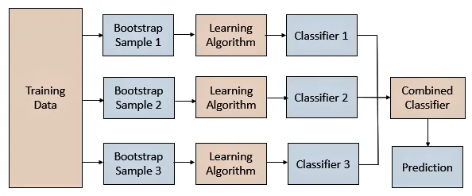
Bagging-based Averaging Learning

Slide 11

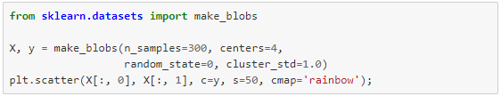
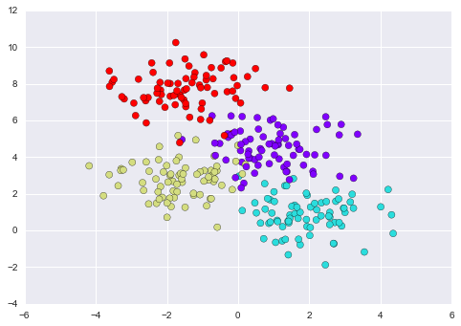
Example

Slide 12
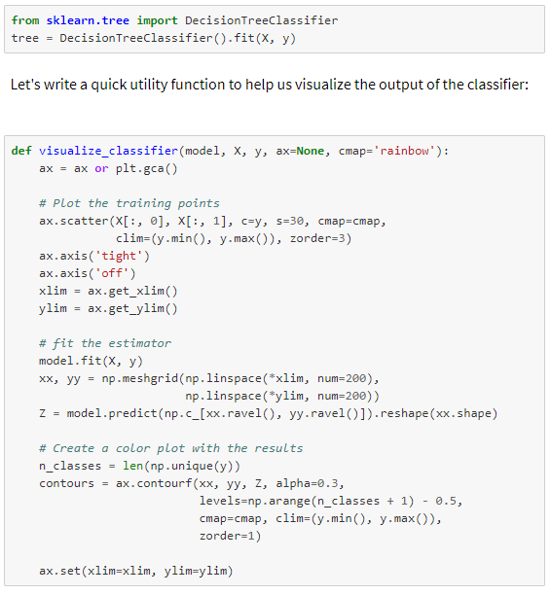
Example

Slide 13
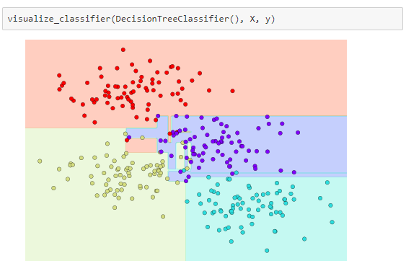
Example

Slide 14
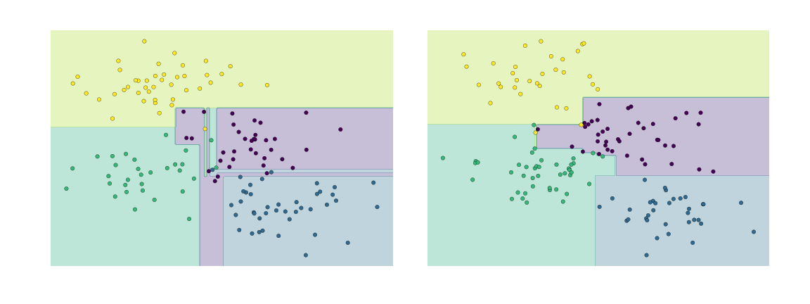
Example
Decision trees and over-fitting: another way to see this over-fitting is to look at models trained on different subsets of the data—for example, in this figure we train two different trees, each on half of the original data:

Slide 15
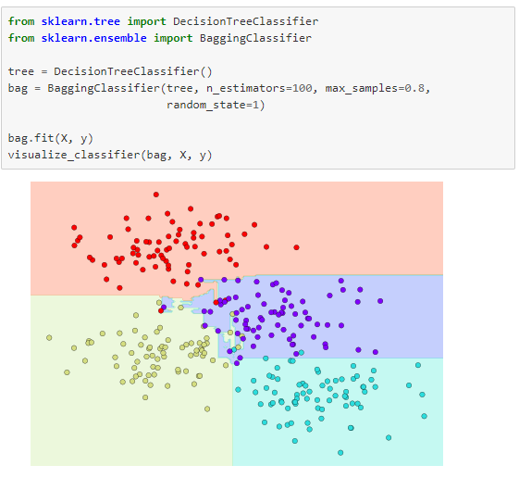
Example
Notes:
In this example, we have randomized the data by fitting each estimator with a random subset of 80% of the training points.

Slide 16
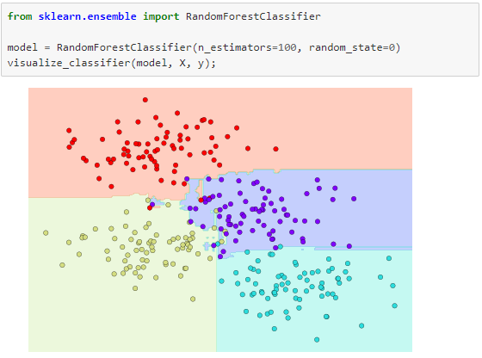
Example
Notes:
In Scikit-Learn, such an optimized ensemble of randomized decision trees is implemented in the RandomForestClassifier estimator, which takes care of all the randomization automatically. All you need to do is select a number of estimators, and it will very quickly (in parallel, if desired) fit the ensemble of trees.

Slide 17
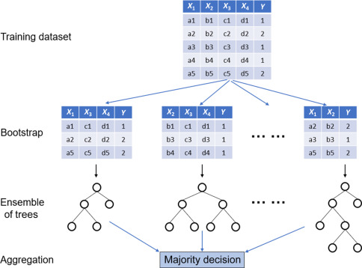
Random Forests with bootstrap
Simplified: a real bootstrap sample has as many rows as the training data and can repeat rows; scikit-learn draws a new random subset of features at every split.

Slide 18
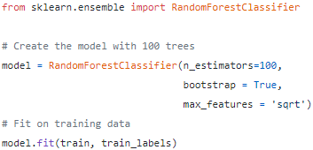
Sklearn Python
Number of trees
Default True: each tree uses a bootstrap sample
max_features = 'sqrt': at every split, a tree tries only √(number of features) randomly chosen features

Slide 19
Outlook
Tree ensembles:
  Bagging and Random Forest (RF)
  Boosting (boosted trees)
K-NN

Slide 20
Boosting: Sequential Reweighting
Boosting, like bagging, is another general approach for improving prediction results for various machine learning methods.
It is also particularly well suited to decision trees.
Rather than resampling the data, however, boosting puts more weight on some examples (those earlier trees got wrong) during learning.
Specifically, in boosting the trees are grown sequentially: each tree is grown using information from previously grown trees.

Slide 21
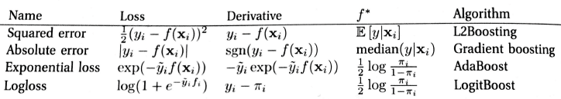
Boosting (cont.)
Here are some commonly used loss functions, gradients, population minimizers, and algorithms to minimize the loss:

Slide 22
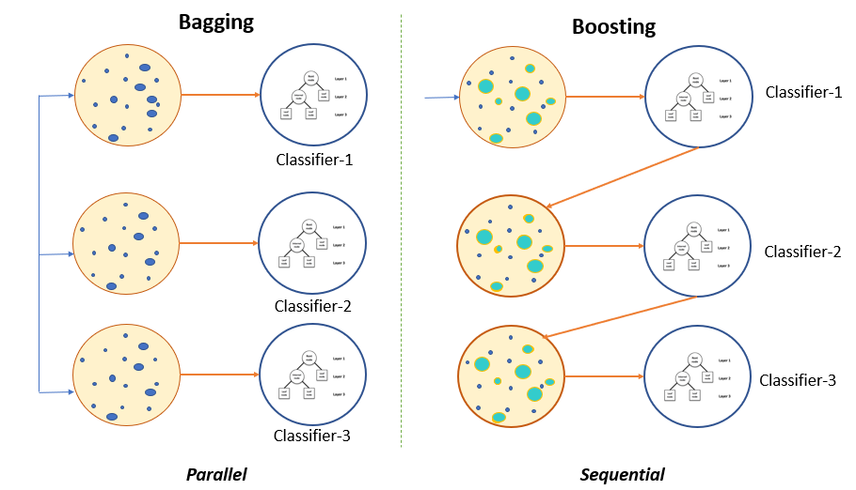
Bagging vs Boosting

Slide 23
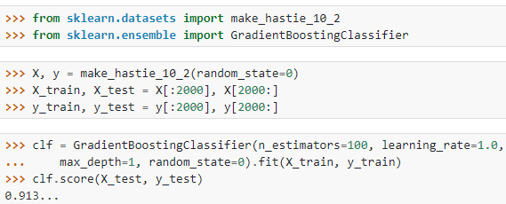
Boosting (cont.)
Boosting is remarkably resistant to overfitting, and it is fast and simple.
In fact, its test error can often keep falling even after the training error has reached zero.
It improves the performance of many kinds of machine learning algorithms.
Boosting does not work when:
  Not enough data, base learner is too weak or too strong, and/or susceptible to noisy data.

Slide 24
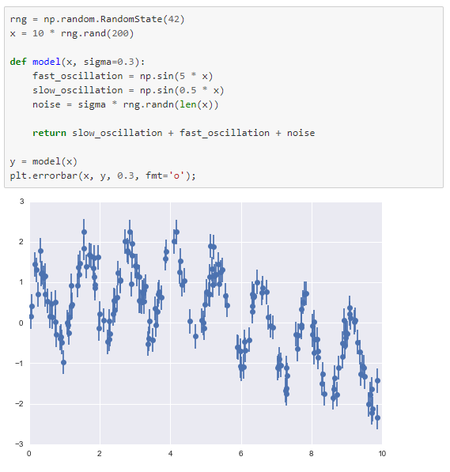
Random Forest Regression
Non-linear regression problem

Slide 25
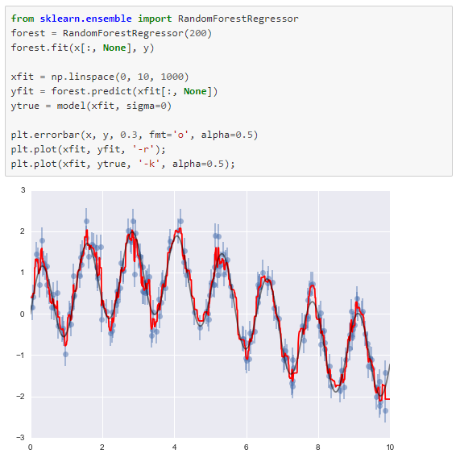
Random Forest Regression

Slide 26
Outlook
Tree ensembles:
  Bagging and Random Forest (RF)
  Boosting (boosted trees)
K-NN

Slide 27
K-NN: An Instance-Based Learning process
Idea:
  Similar examples have similar labels.
  Classify new examples like similar training examples.
Algorithm:
  Given some new example x for which we need to predict its class y
  Find most similar training examples
  Classify x “like” these most similar examples
Questions:
  How to determine similarity?
  How many similar training examples to consider?
  How to resolve inconsistencies among the training examples?
Notes:
Similar inputs map to similar outputs
If not true => learning is impossible
If true => learning reduces to defining “similar”

Slide 28
k-NN Approach
The simplest, most used instance-based learning algorithm is the k-NN algorithm
k-NN assumes that all instances are points in some n-dimensional space and defines neighbors in terms of distance (usually the Euclidean distance in ℝ^{n})
k is the number of neighbors considered

Slide 29
1-Nearest Neighbor
One of the simplest of all machine learning classifiers
Simple idea: label a new point the same as the closest known point
Label it red.

Slide 30
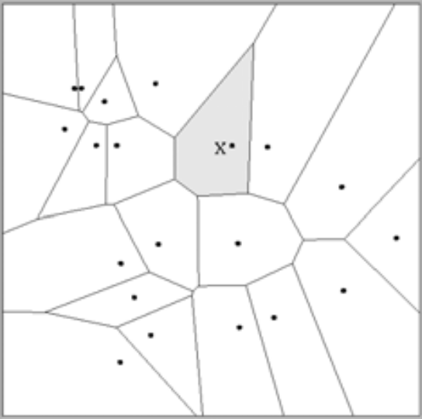
1-Nearest Neighbor
A type of instance-based learning
  Also known as “memory-based” learning
Forms a Voronoi tessellation of the instance space

Slide 31
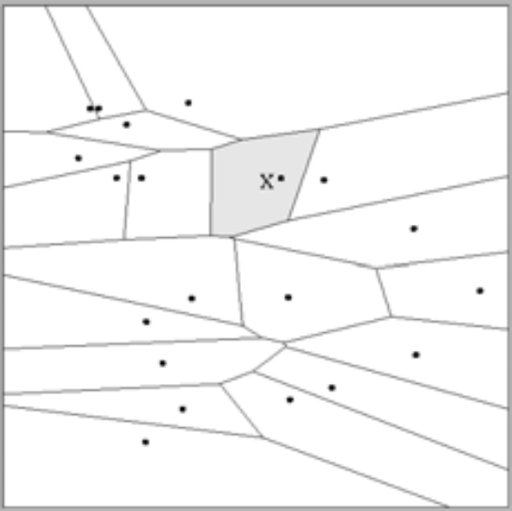
Distance Metrics
Different metrics can change the decision surface
Standard Euclidean distance metric:
  Two-dimensional: Dist(a,b) = sqrt((a₁ – b₁)² + (a₂ – b₂)²)
  Multivariate: Dist(a,b) = sqrt(∑ (a_{i} – b_{i})²)
Dist(a,b)² =(a₁ – b₁)² + (a₂ – b₂)²
Dist(a,b)² =(a₁ – b₁)² + (3a₂ – 3b₂)²

Slide 32
1-NN’s Aspects as an
Instance-Based Learner:
A distance metric
  Euclidean
  When different units are used for each dimension
    → normalize each dimension by standard deviation
  For discrete data, can use Hamming distance
    → D(x1,x2) = number of features on which x1 and x2 differ
  Others (e.g., Manhattan, Mahalanobis, cosine)
How many nearby neighbors to look at?
  One
How to fit with the local points?
  Just predict the same output as the nearest neighbor.
Adapted from “Instance-Based Learning”
lecture slides by Andrew Moore, CMU.

Slide 33
k – Nearest Neighbor
Generalizes 1-NN to smooth away noise in the labels
A new point is now assigned the most frequent label of its k nearest neighbors
Label it red, when k = 3
Label it blue, when k = 7

Slide 34
Selecting the Number of Neighbors
Increase k:
  Makes KNN less sensitive to noise
Decrease k:
  Allows capturing finer structure of space
➔Pick k not too large, but not too small (depends on data)

Slide 35
Curse-of-Dimensionality
Prediction accuracy can quickly degrade when number of attributes grows.
  Irrelevant attributes easily “swamp” information from relevant attributes
  When many irrelevant attributes, similarity/distance measure becomes less reliable
Remedy
  Try to remove irrelevant attributes in pre-processing step
  Weight attributes differently
  Increase k (but not too much)
Notes:
Prediction accuracy can quickly degrade when number of attributes grows.
Imagine attribute vector (y,r1,r2,r3,…,rN),
first feature always tells the label
r1,…,rN take random binary values.
What is the probability that the nearest neighbor has the same label? P(y=yNN)
Similarity measure is number of mismatches.
Assume we have only two training examples, one for each label. Both training examples have distance N+1 (all bits different)
(-1,+1,-1,+1,-1,+1,…,-1)
(+1,-1,+1,-1,+1,-1,…,+1)
If N=0, then P(y=yNN)=1
If N=2, then P(y=yNN)=3/4
→ need both random attributes to match the wrong example
(4 outcomes on random attributes, and only one leads to a mistake)
If N=4, then P(y=yNN)=11/16
→ need at least three random attributes to match the wrong example
(16 outcomes on random attributes, and 5 lead to a mistake)
If N=100, then P(y=yNN) almost 1/2
→ need N/2+1 random attributes to match the wrong example
For every random attribute, we need exponentially more training examples.

Slide 36
Advantages and Disadvantages of KNN
Need distance/similarity measure and attributes that “match” target function.
For large training sets,
→ Must make a pass through the entire dataset for each classification. This can be prohibitive for large data sets.
Prediction accuracy can quickly degrade when number of attributes grows.
Simple to implement algorithm;
Requires little tuning;
Often performs quite well!
(Try it first on a new learning problem).
Notes:
Need similarity measure and attributes that “match” target function
predicting a person’s height may depend on different attributes than predicting their IQ

Slide 37

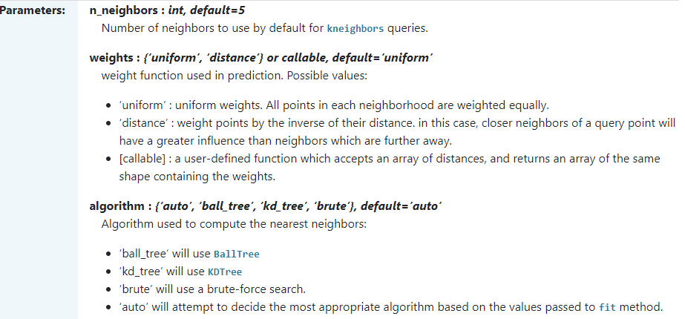
K-NN in Python
https://scikit-learn.org/stable/modules/generated/sklearn.neighbors.KNeighborsClassifier.html

Slide 38
How do you decide the number of neighbours in KNN?
Research has shown that no optimal number of neighbours suits all kinds of data sets. Each dataset has its own requirements. In the case of a small number of neighbours, the noise will have a higher influence on the result, while a large number of neighbours blurs the boundaries between classes and makes it more computationally expensive.
With two classes, data scientists usually choose an odd k, so that the vote cannot end in a tie.
You can also try the elbow method here.

Slide 39
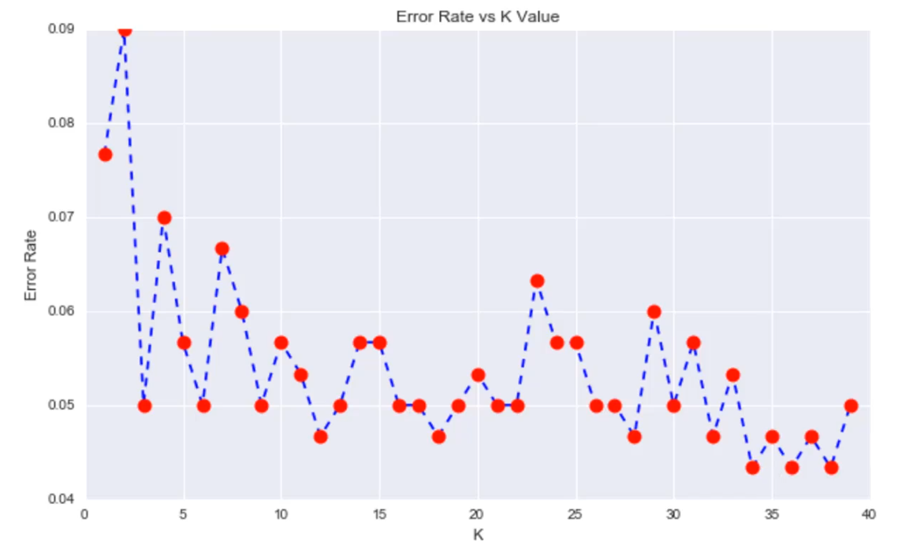
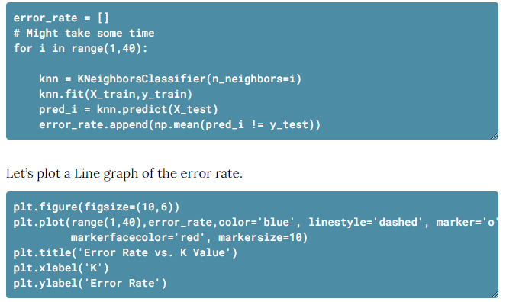
Elbow method
k = 22: the error rate stays low from about k = 12 to 22 and jumps at k = 23
22

Slide 40
Summary
This section contained:
1. A brief introduction to tree ensembles: bagging, random forests (ensembles of randomized decision trees) and boosting.
2. K-NN algorithm
Lab: Go through the K-NN practice notebook on the course website (Week 7, 3 Tutorial)
Next week:
Unsupervised learning e.g. k-means to solve clustering problem

Slide 41
Online reference
https://www.datacamp.com/tutorial/k-nearest-neighbor-classification-scikit-learn

